Slide 1


Unit 1
Site conditions - IPC
Notes:
Welcome to Unit 1 of Module 5.

Slide 2
By the end of this unit, you will be able to:
assess and record the availability of IPC items at various service sites within a health facility
Notes:
By the end of this unit, you will be able to correctly assess and record the availability of IPC items at various service sites within a health facility.

Slide 3
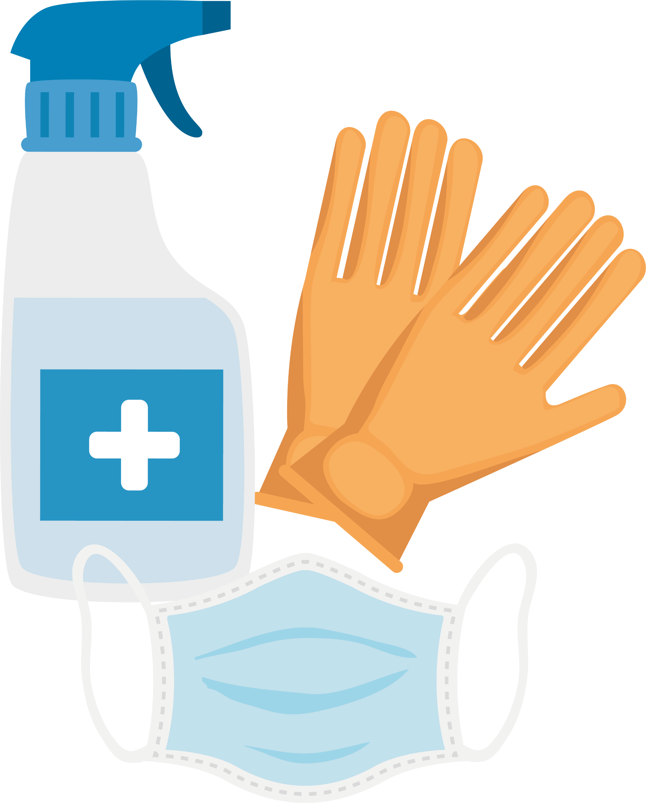




Infection prevention and control
When collecting data on site conditions, some items are assessed in multiple service sites.
Example: IPC, items should be present in multiple service sites as they are required for minimizing infection in all areas of service delivery.
Notes:
When collecting data on site conditions, some items are assessed in multiple service sites.
For example, infection prevention and control, or IPC, items should be present in multiple service sites as they are required for minimizing infection in all areas of service delivery.

Slide 4
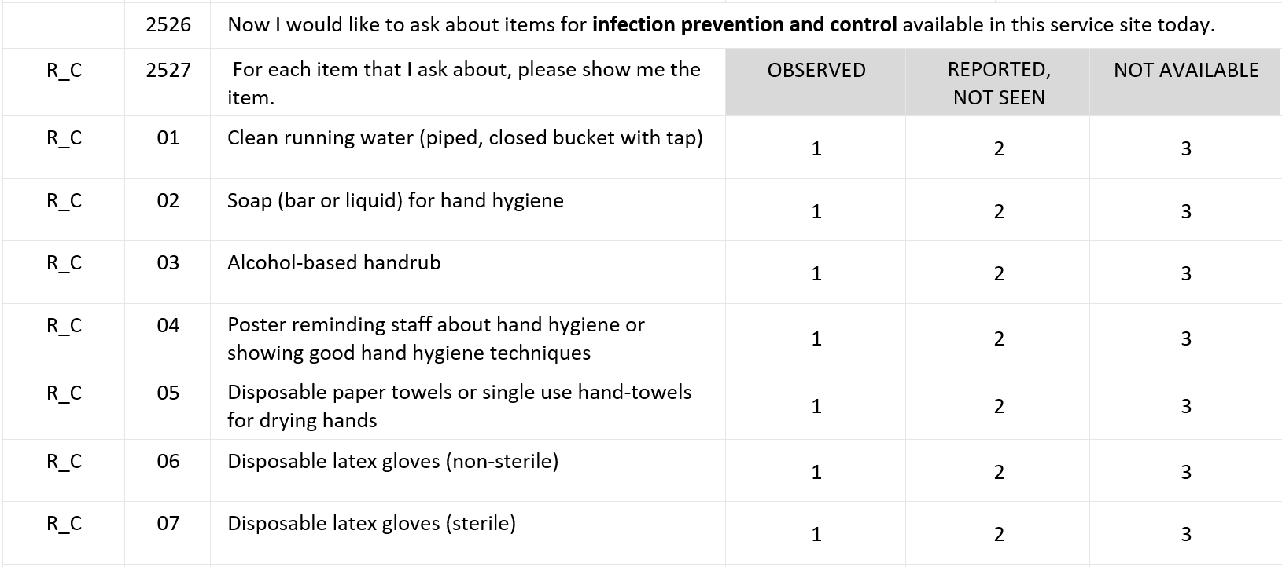
Infection prevention and control
National
Notes:
Question 2527 focuses on IPC. As it has several response options, it is displayed as a response table where:​
​
the rows show the different resources or supplies for IPC; and ​
the columns capture information about availability through observation.

Slide 5
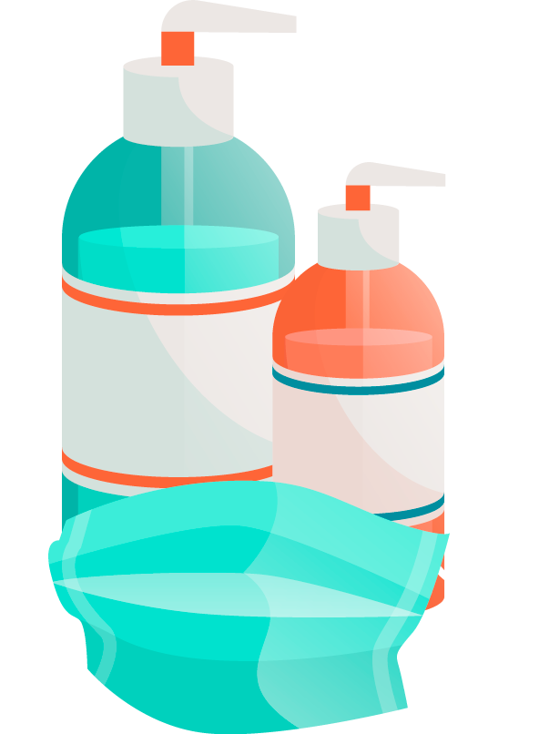
Infection prevention and control
22 items in IPC list
not all service areas use all items
items listed depend on site requirements
Example
outpatient area list doesn’t have a biological waste receptacle bin
laboratory list does have a biological waste receptacle bin
Notes:
The total IPC list consists of 22 items, however not all service areas will use the full list of items. The items listed will depend on the requirements of each site.
For example, the outpatient area list doesn’t contain a waste receptacle bin for biological waste, but the laboratory list does.

Slide 6
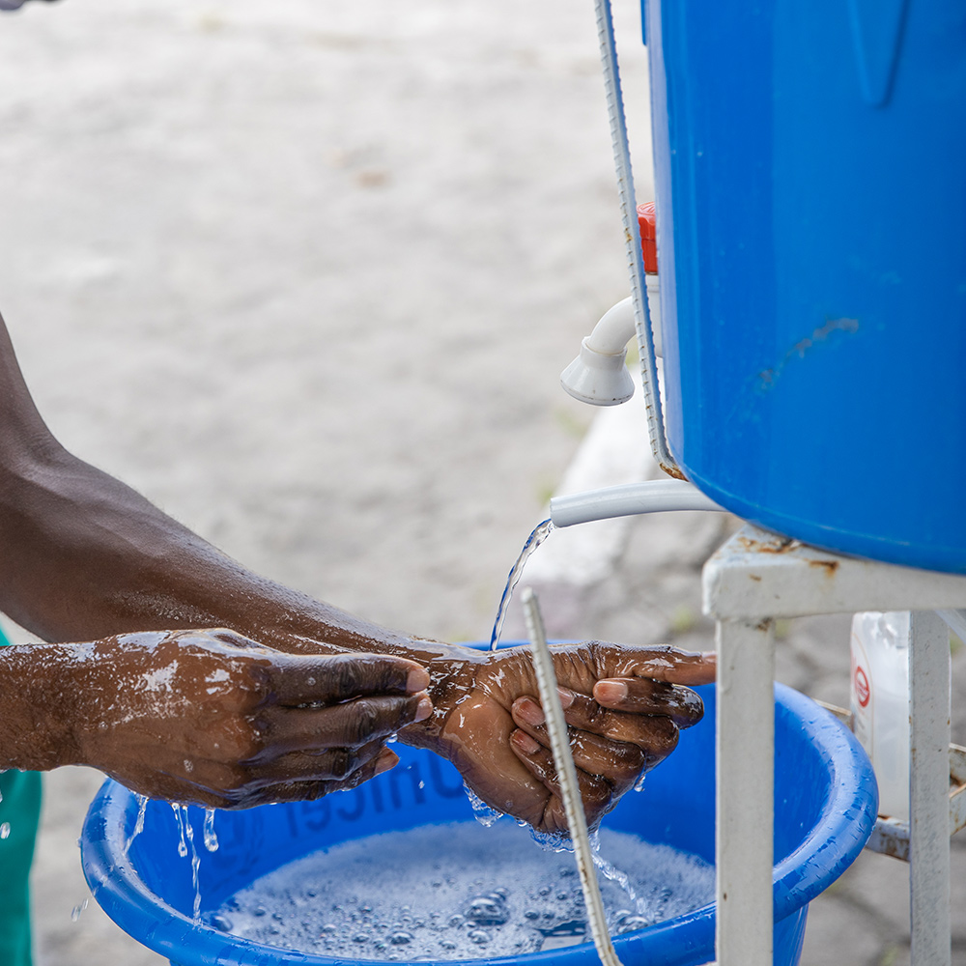
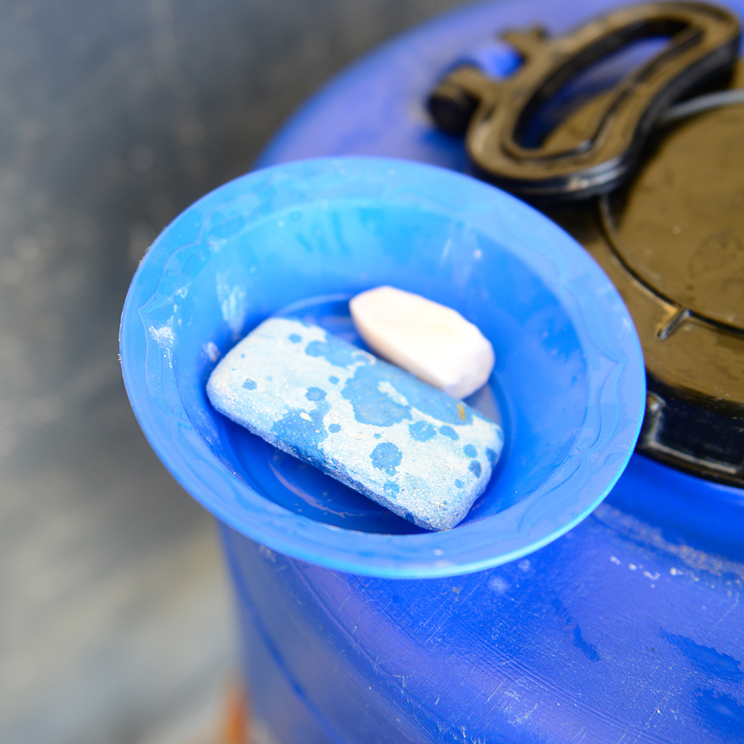
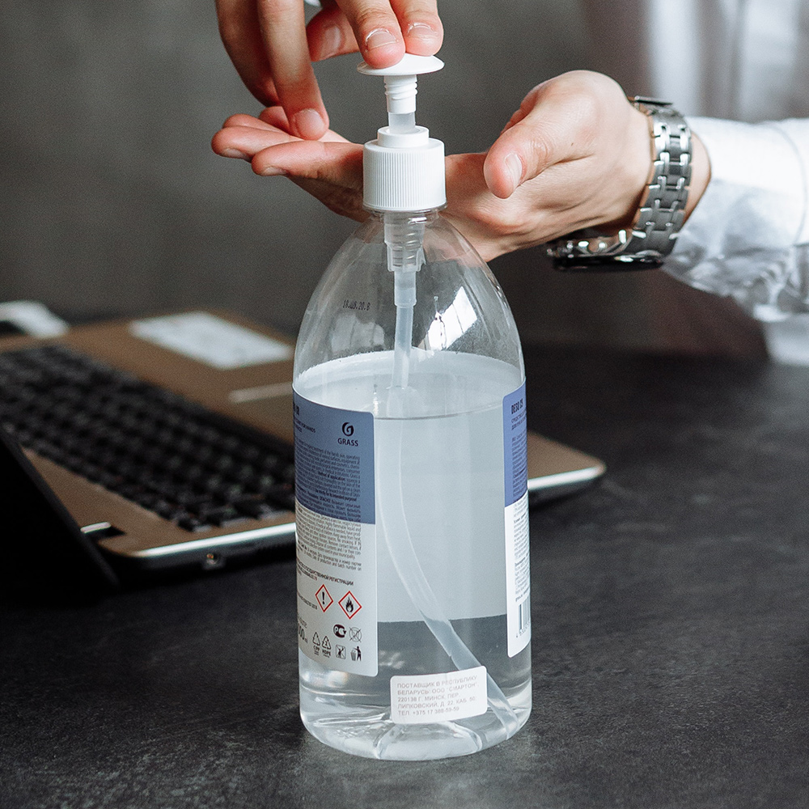
Infection prevention and control list
1. Clean running water
2. Soap for hand
hygiene
3. Alcohol-based hand rub
© WHO / Daniel Elombat
© WHO
Photo by Thirdman on Pexels
Notes:
Let’s now walk through the list of 22 IPC items.
1. Clean running water, which must be from a clean source and must be single use.
If running water is not piped into the room where services are delivered, a container – usually a bucket with a tap that water can flow from – is an acceptable option.
The main point is that the water is not reused.
2. Soap for hand hygiene. Any soap used for hand-washing is acceptable.
3. Alcohol-based hand rub, which can be a supplement or alternative to hand washing with soap and water.

Slide 7
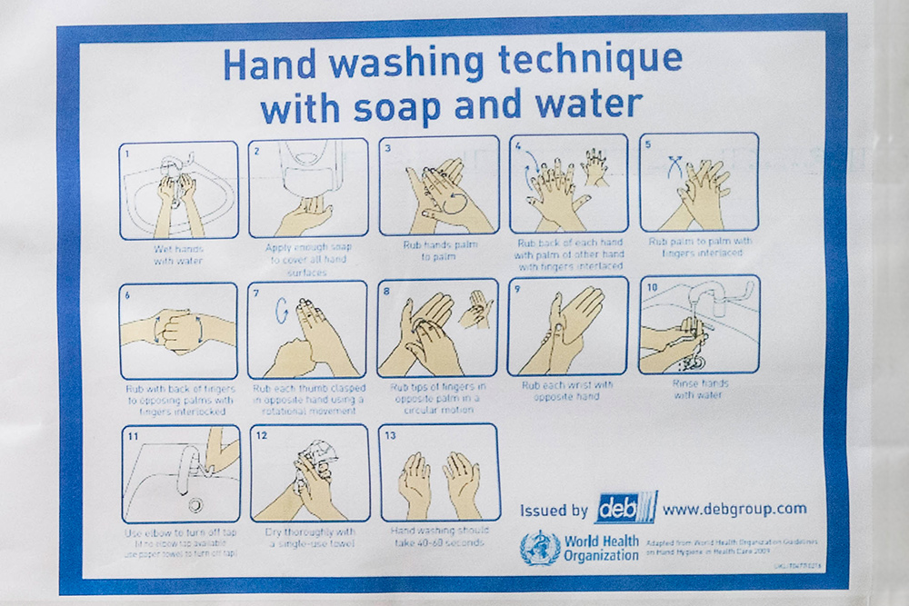
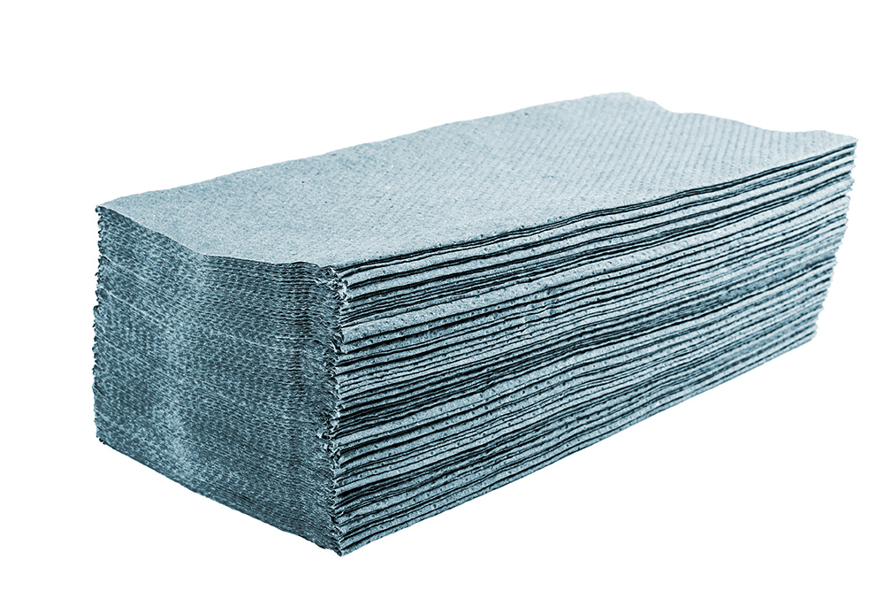
Infection prevention and control list
4. A poster or sign reminding staff about hand hygiene or showing good hand hygiene techniques
5. Disposable paper towels or single use hand-towels for drying hands
© WHO / Blink Media - Nana Kofi Acquah
Designed by Freepik
Notes:
4. A poster or sign reminding staff about hand hygiene or showing good hand hygiene techniques.
5. Disposable paper towels or single use hand-towels for drying hands.

Slide 8
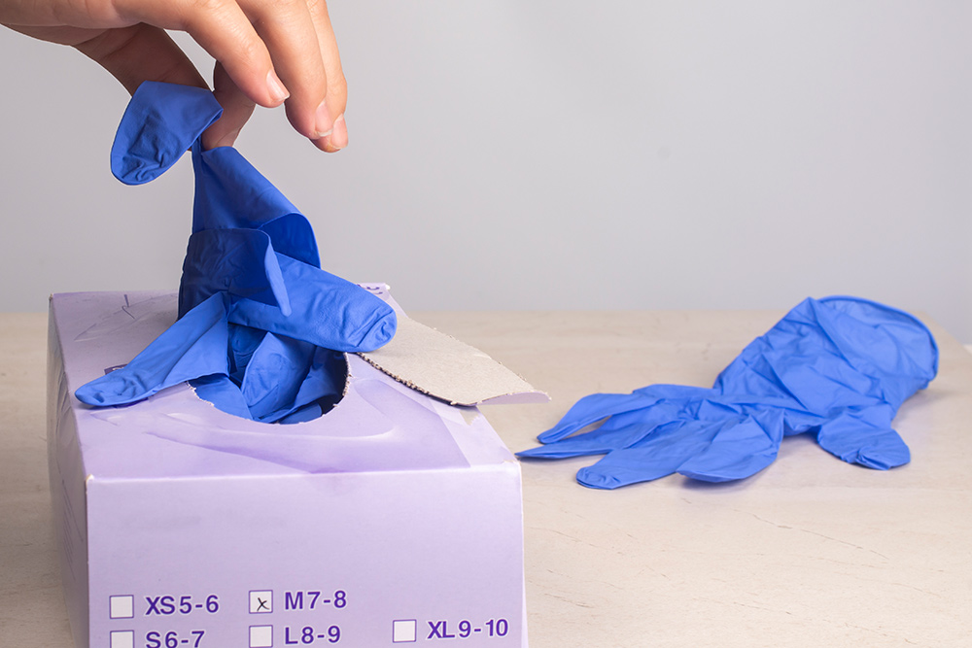
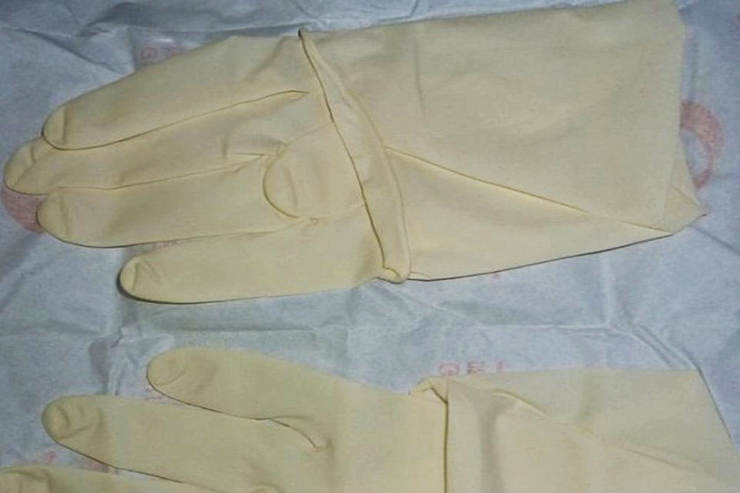
Infection prevention and control list
6. Disposable latex gloves (non-sterile)
7. Disposable latex gloves
(sterile)
Used for examining patients, waste disposal etc.
Used for surgical procedures
© WHO
© WHO
Notes:
6. Disposable latex gloves (non-sterile), which are designed as protective barriers when worn on the hands of health care providers during various procedures. These usually come in a box where the gloves are not individually packaged.
7. Disposable latex gloves (sterile), which come in a packet with one pair per packet.
Sterile gloves are required for surgical procedures. Non-sterile gloves are used for other procedures where the health worker should be protected but a sterile environment is not needed – such as examining patients, disposing of waste, etc.

Slide 9
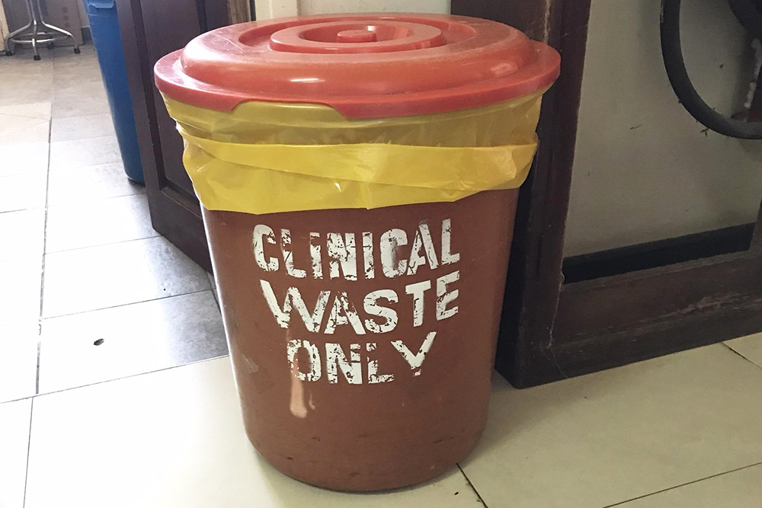
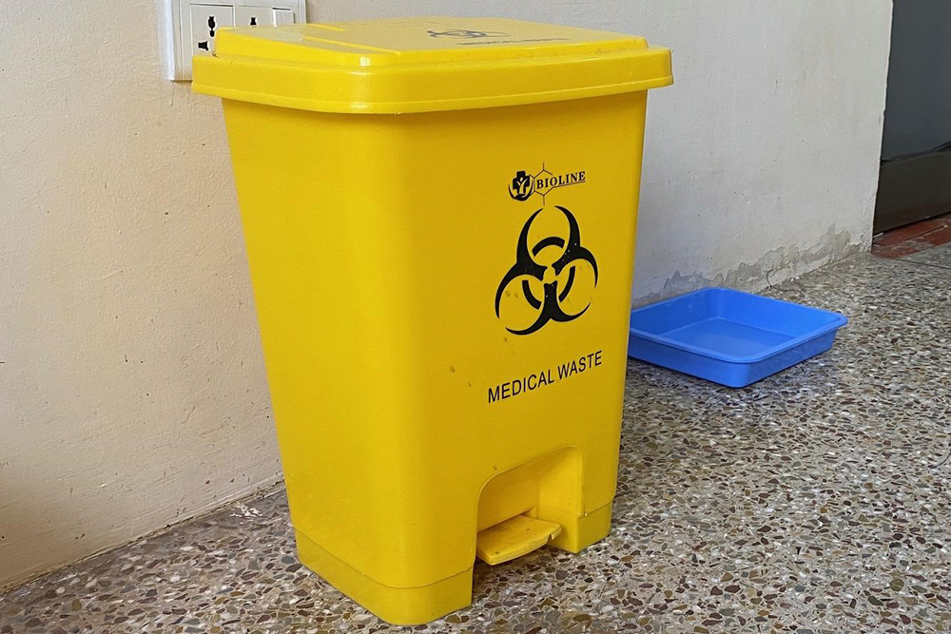
Infection prevention and control list
8. Waste receptacle bin with lid and plastic bin liner for infectious non-sharp waste
9. Foot pedal operated waste bin for infectious non-sharp waste
© WHO / Yolanda Barbera
© WHO / Yolanda Barbera
Notes:
8. Waste receptacle bin with lid and plastic bin liner for infectious non-sharp waste, such as bandages and other non-sharp items that may be contaminated with blood or other body fluids. The bin must be marked in some manner, and must have a lid and a plastic liner.
9. Foot pedal operated waste bin for infectious non-sharp waste. In addition, the waste bin could have a functional foot pedal to help prevent the outside of the bin from being touched by contaminated materials or hands.

Slide 10
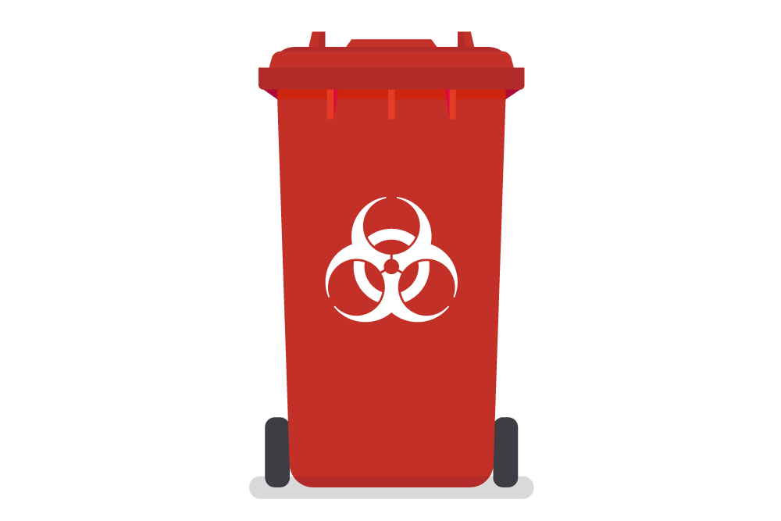
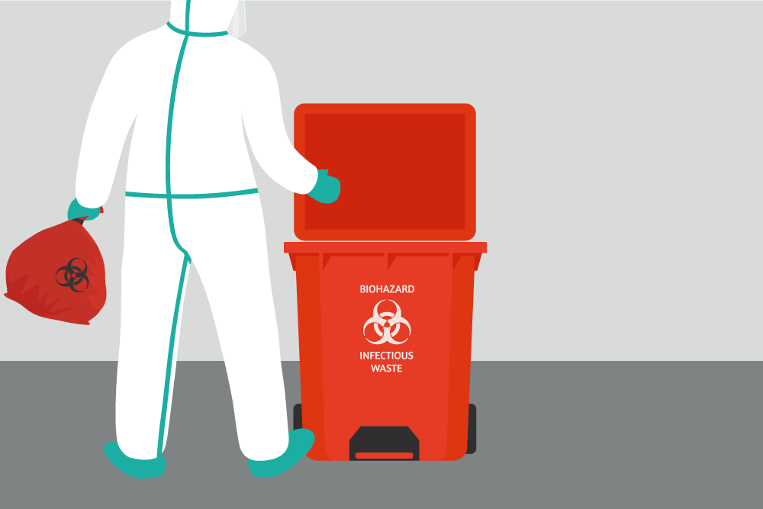
Infection prevention and control list
10. Waste receptacle bin with lid and plastic bin liner for biological waste (body parts)
11. Foot pedal operated waste bin for biological waste
Image used under license from Shutterstock.com
Image used under license from Shutterstock.com
Notes:
10. Waste receptacle bin with lid and plastic bin liner for biological waste. Biological waste refers to body parts. The bin must be marked in some manner, and must have a lid and a plastic liner.​
11. Foot pedal operated waste bin for biological waste.

Slide 11
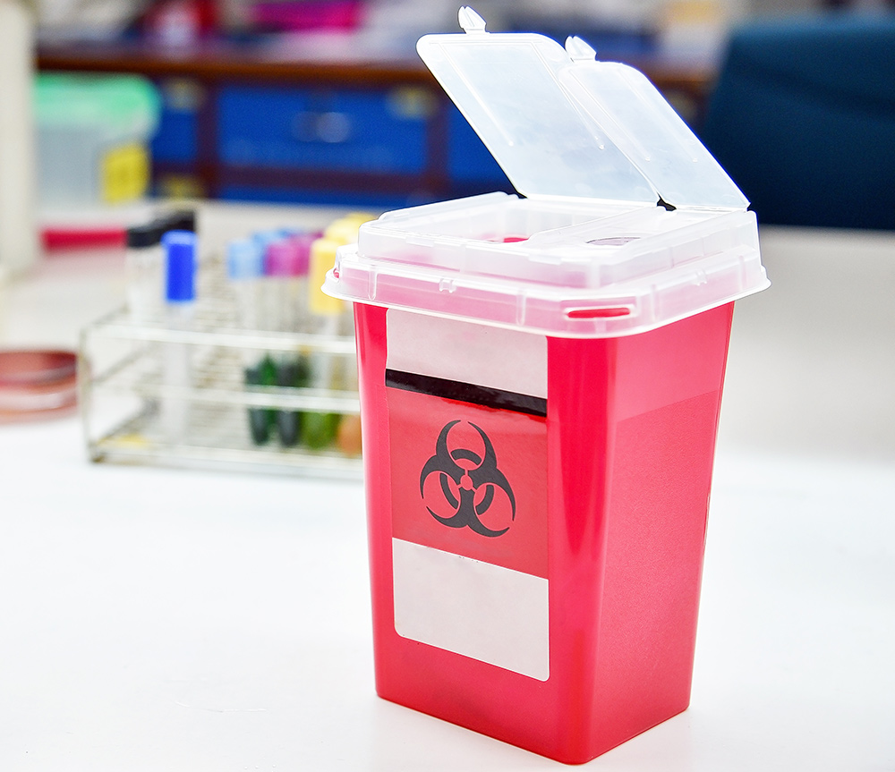
Infection prevention and control list
12. Sharps container
for needles, lancets, scalpel blades, cannula, other devices
puncture resistant
leakproof
disposable
Image used under license from Shutterstock.com
Notes:
12. Sharps container, which allows the safe deposit and collection of biologically or chemically contaminated used sharps – such as needles, lancets, scalpel blades, cannula, or other devices that present a hazard to a health care worker or patient.
This container is typically designed to be:
puncture resistant;
leak-proof; and
disposable.
It is identified with the universal biohazard symbol on its labeling.

Slide 12
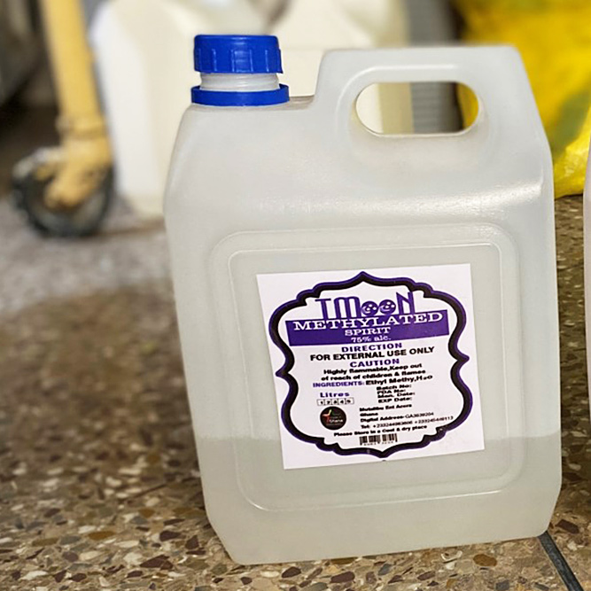
Infection prevention and control list
13. Environmental disinfectant
Used on surfaces such as:
toilet seats
telephones
wash basins
metal beds
lockers
door knobs
© WHO / Yolanda Barbera
Notes:
13. Environmental disinfectant, which includes bleach and alcohol used on surfaces such as:
toilet seats;
telephones;
wash basins;
metal beds;
lockers; and
door knobs, etc.

Slide 13
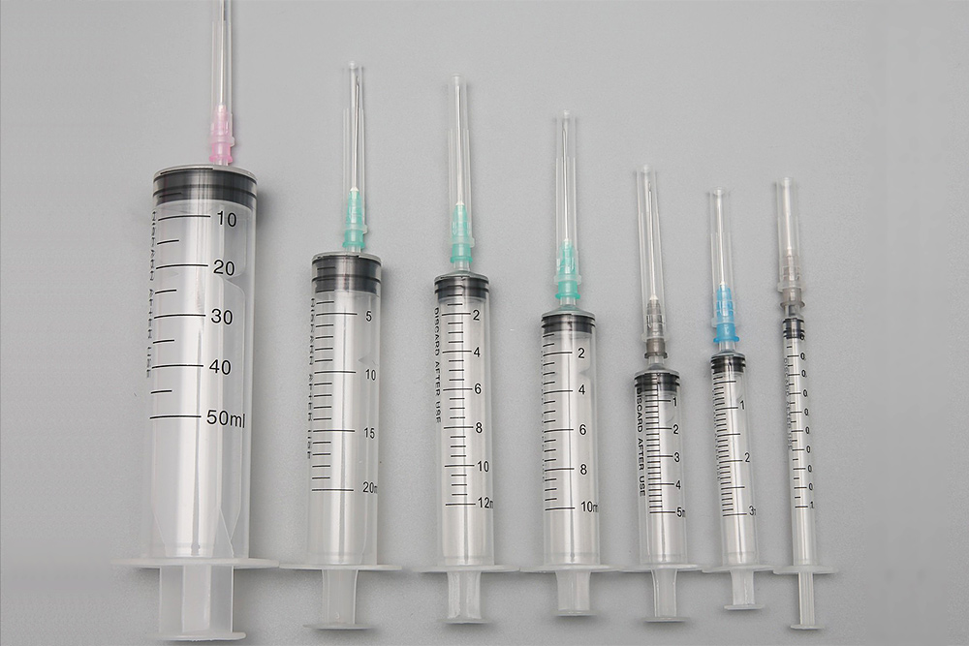
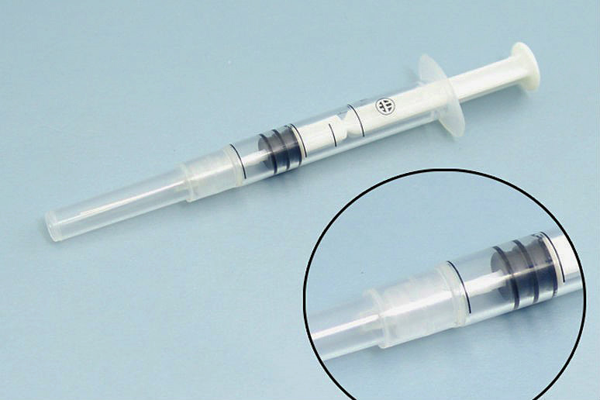
Infection prevention and control list
14. Non-reusable syringes
All-plastic syringe with a separate needle designed for a single use
A specifically modified disposable syringe with a fixed needle
© WHO
© WHO
Notes:
14. Non-reusable syringes. This could be:
an all-plastic syringe with a separate needle designed for a single use; or
a specifically modified disposable syringe with a fixed needle, which is automatically disabled by the plunger blocking after a single use.

Slide 14
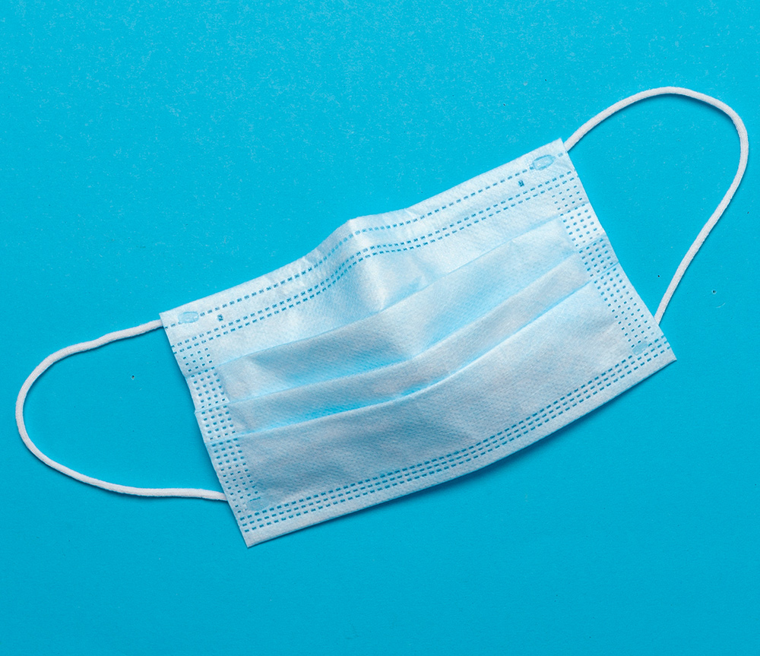
Infection prevention and control list
15. Surgical masks
for health care workers, to protect them against large droplets of bodily fluids/to protect patients from the wearer’s respiratory emissions
for patients who have a cough/suspected respiratory illness (including TB or COVID-19), to protect others
Designed by Freepik
Notes:
15. Surgical masks, for:
health care workers, to protect themselves against large droplets, splashes, or sprays of bodily fluids, and to protect patients from the wearer’s respiratory emissions; and ​
patients who have a cough or suspected severe respiratory illness, including TB or COVID-19, to protect other people from infectious respiratory emissions.

Slide 15
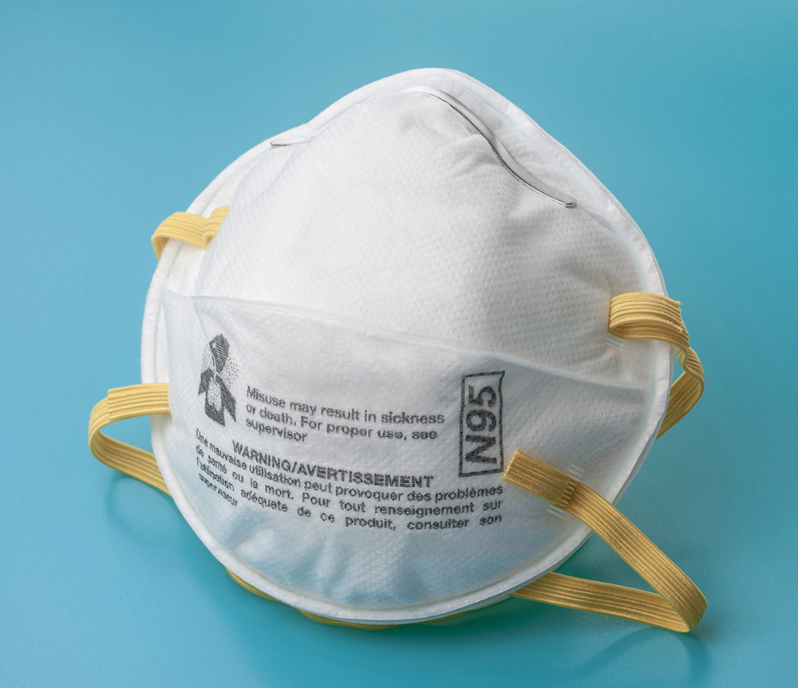
Infection prevention and control list
16. N95 face masks
for health workers, to protect them against small particle aerosols and large droplets of bodily fluids
Image used under license from Shutterstock.com
Notes:
16. N95 face masks, for health workers, to protect them against small particle aerosols and large droplets of bodily fluids.

Slide 16

Infection prevention and control list
17. and 18. Protective gowns
non-sterile gowns
may be disposable
often made of reusable materials
sterile gowns
wrapped in a cover that is taped shut/autoclaved
Designed by Freepik
Notes:
17. and 18. Protective gowns. These are provided by the facility for staff to put on over their uniforms to protect them from contamination.
non-sterile gowns may be disposable (e.g. paper or plastic), but are often made of reusable materials;
sterile gowns are usually wrapped in a cloth or paper cover that is taped shut and that has been autoclaved.

Slide 17
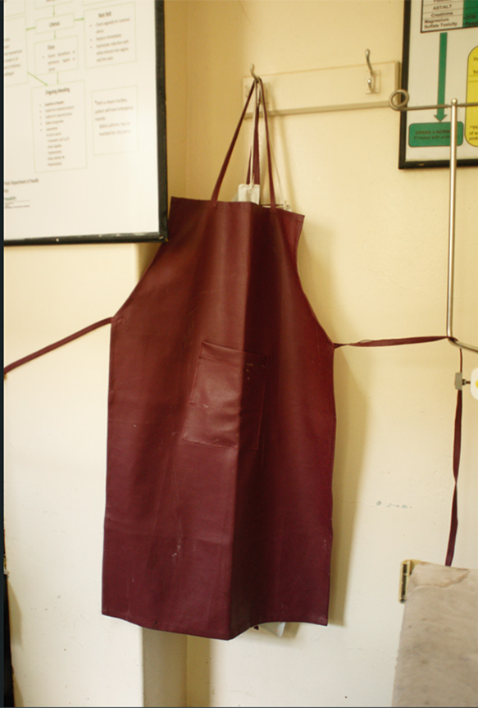
Infection prevention and control list
19. Aprons
for staff, to protect uniforms
liquids cannot pass through
may be full gown/ cover front of a uniform
used for fluid spatter/ other possible contamination
© WHO / Yolanda Barbera
Notes:
19. Aprons are for staff to protect their uniforms. Liquids cannot pass through.
The apron may be a full gown or simply cover the front of a uniform. These are used where there may be spatter of fluids or other contamination that could soak through a different type of protective gown.

Slide 18
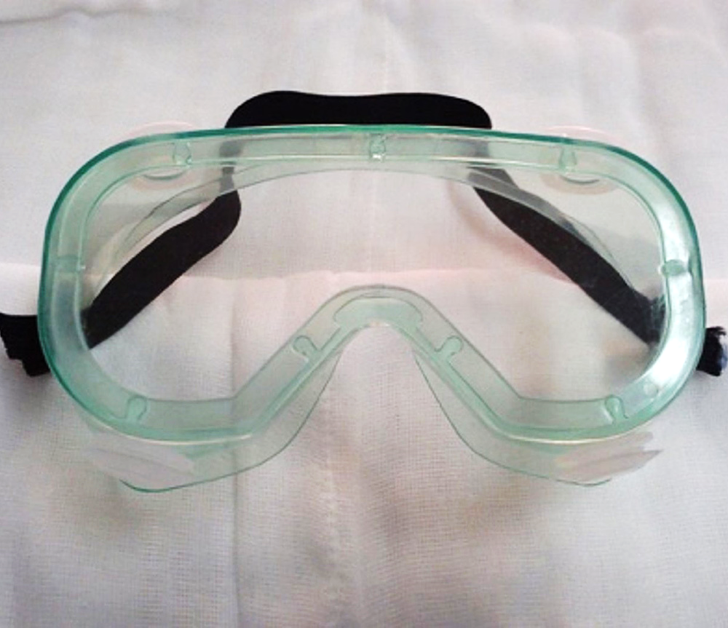
Infection prevention and control list
20. Eye protection
(such as goggles, face shields or other eyewear)
used to protect eyes from contamination by bodily fluids
© WHO
Notes:
20. Eye protection (such as goggles, face shields or other eyewear).
These are used to protect the eyes from being contaminated by bodily fluids when managing patients.

Slide 19
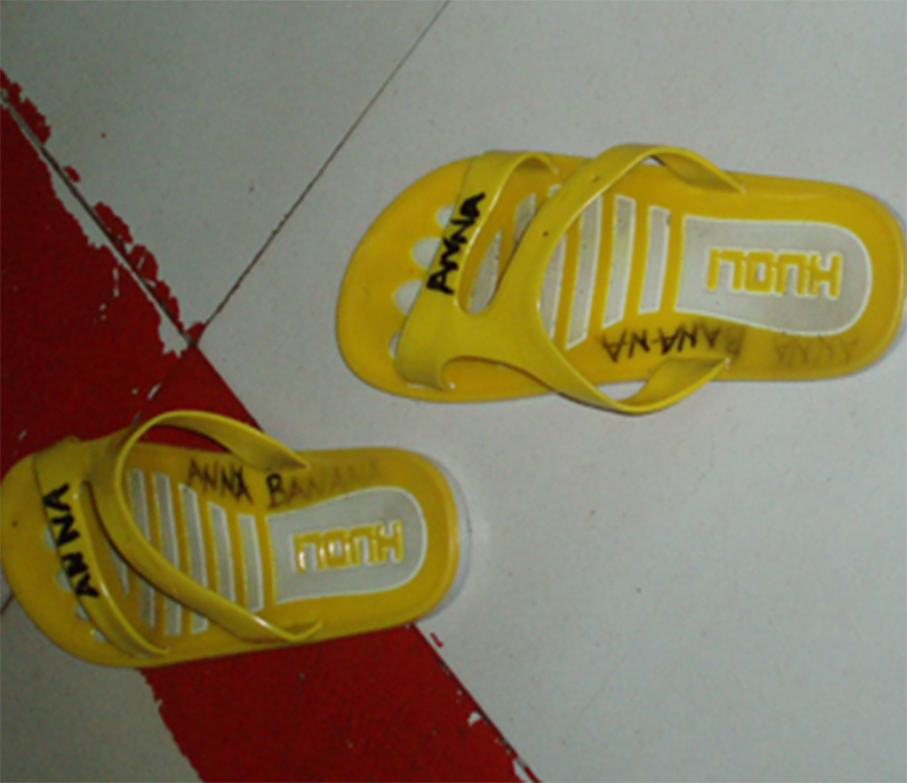
Infection prevention and control list
21. Gumboots or clogs
rubber footwear
provided by the facility
stay in the service area
© WHO / Yolanda Barbera
Notes:
21. Gumboots or clogs, which are rubber footwear provided by the facility that stay in the service area.

Slide 20
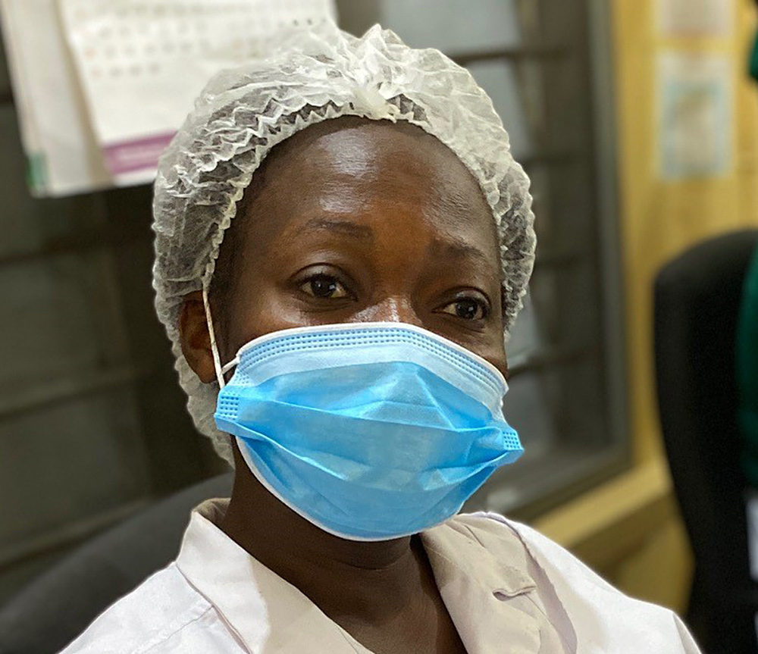
Infection prevention and control list
22. Hair cover
disposable cloth cap/ scarf/bandana
encases the hair
stops hair from contaminating a procedure area
© WHO / Yolanda Barbera
Notes:
22. Hair cover, which may be a disposable cloth cap, a scarf or bandana that ties around the head to encase the hair.
These are often used to prevent hair from contaminating a procedure area.

Slide 21
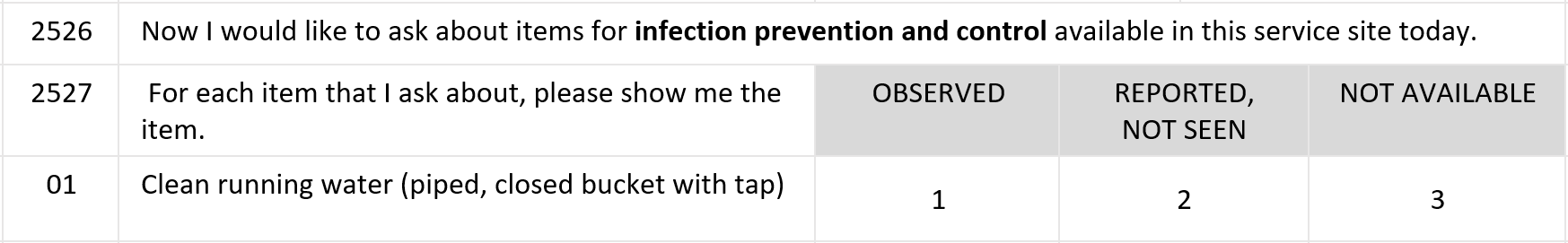
Questionnaire content: What do the questions ask about?
The following criteria are used for classifying availability of an item:
"1" for "OBSERVED":
Select “1” when you have seen the item:
in the service site
in a nearby room where it can easily be accessed when needed
Notes:
The following criteria are to be used for classifying the availability of an item:
"1" for "OBSERVED":
Select “1” when you have seen the item in the service site or in a nearby room where it can easily be accessed by the provider when needed for the service.

Slide 22
Questionnaire content: What do the questions ask about?
"2" for "REPORTED, NOT SEEN":
Select “2” when the respondent reports the item is available, but you cannot observe the item. For example:
a key to a cabinet is missing
a room is locked
the service is not being provided at the time of the visit
the item is stored elsewhere
Notes:
"2" for "REPORTED, NOT SEEN":
Select “2” any time the respondent reports that the item is available in the service site or in a nearby room where it can easily be accessed when needed, but for some reason you cannot observe the item.
For example:
if a key to a cabinet is missing;
a room is locked;
the service is not being provided at the moment of the visit; or
the item is stored somewhere else.

Slide 23
Questionnaire content: What do the questions ask about?
"2" for "REPORTED, NOT SEEN":
In smaller facilities many rooms are near each other.
It is reasonable to assume that equipment is shared between rooms.
Notes:
Please note, in smaller facilities many rooms are near each other (e.g. one can walk from room to room in less than one minute) and it is reasonable to assume that equipment can be shared between the various rooms.

Slide 24



Questionnaire content: What do the questions ask about?
Example:
antenatal care
“REPORTED, NOT SEEN”
family planning
Notes:
For example, if a blood pressure apparatus is shared between the antenatal care and the family planning services, the data collector can record “REPORTED, NOT SEEN” if the service is not being provided at the moment in one of the sites and the respondent says the item is available when the service needs it.

Slide 25
Questionnaire content: What do the questions ask about?
“3” for “NOT AVAILABLE”:
Select “3” when the respondent reports that the item is not available:
in the service site
in a nearby room where it can easily be accessed when needed
Notes:
“3” for “NOT AVAILABLE”:​
Select “3” when the respondent reports that the item is not available in the service site or in a nearby room where it can easily be accessed when needed.

Slide 26
Questionnaire content: What do the questions ask about?
Example:
antenatal care
“NOT AVAILABLE”
family planning
Notes:
Let’s look again at the example of the blood pressure apparatus being shared between antenatal care and family planning services. This item would be considered “NOT AVAILABLE” if:
none of the sites have it;
it is in one of the sites, but the other service site cannot access it when needed because both services are provided at the same time.

Slide 27
You have now completed Unit 1.
In the next unit, we will look at data collection on site conditions for cleanliness and safety.
Notes:
You have now completed Unit 1.
In the next unit, we will look at data collection on site conditions for cleanliness and safety.

